Slide 1

Logistic Regression
Notes:
Note: Please after inserting your picture, “Right Click” on the picture and “Send it to Back” to get the “Gradient” effect.

Slide 2
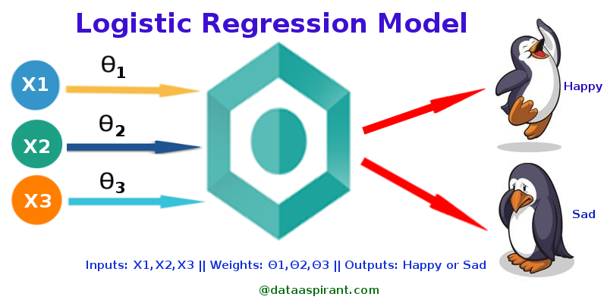
Introduction
Logistic regression is a fundamental supervised machine learning algorithm used for binary classification. Instead of predicting continuous numerical values like linear regression, it calculates the probability that a given data point belongs to a specific category (e.g., true/false or yes/no)
Notes:
Ramon Perez is a Data Scientist with a vast experience in data analytics in roles ranging from industry and academic research to data science education. For the past two years, he had been working on developing what will hopefully become the first accredited data science bootcamp outside of a university setting in Australia. In the academic space, he has taught statistical programming at London Business School and have had the privilege to tutor and create lessons for a wide range of quantitative courses at Johns Hopkins Carey Business School. In addition, He has given tutorials at PyCon US, APAC, and Chile in 2021, SciPy Japan 2020, SciPy US 2021. He has also worked as a researcher at INSEAD where he developed machine learning models to recreate the organizational structure of any given company based on its historical job ads and those of similar companies. This project used a massive database of millions of job ads posted over the last 14 years in the US.

Slide 3
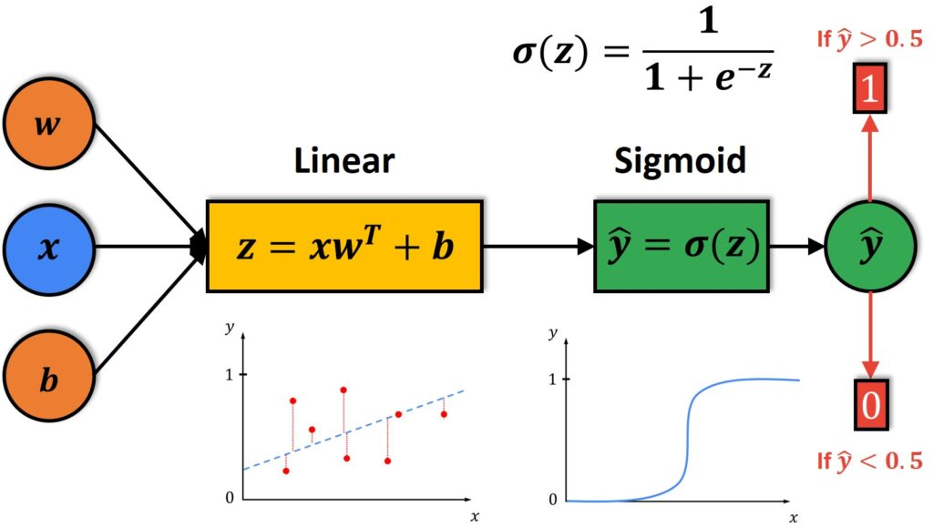

Working
How it Works
Instead of fitting a straight line to data, logistic regression applies the mathematical logistic (sigmoid) function to map predictions to an S-shaped curve
The Output: It yields a probability score ranging between (0) and (1).
The Decision Boundary: A threshold (usually (0.5)) is set. Probabilities above the threshold map to the positive class ((1)); those below map to the negative class ((0)).
The Math:
Notes:
Ramon Perez is a Data Scientist with a vast experience in data analytics in roles ranging from industry and academic research to data science education. For the past two years, he had been working on developing what will hopefully become the first accredited data science bootcamp outside of a university setting in Australia. In the academic space, he has taught statistical programming at London Business School and have had the privilege to tutor and create lessons for a wide range of quantitative courses at Johns Hopkins Carey Business School. In addition, He has given tutorials at PyCon US, APAC, and Chile in 2021, SciPy Japan 2020, SciPy US 2021. He has also worked as a researcher at INSEAD where he developed machine learning models to recreate the organizational structure of any given company based on its historical job ads and those of similar companies. This project used a massive database of millions of job ads posted over the last 14 years in the US.

Slide 4
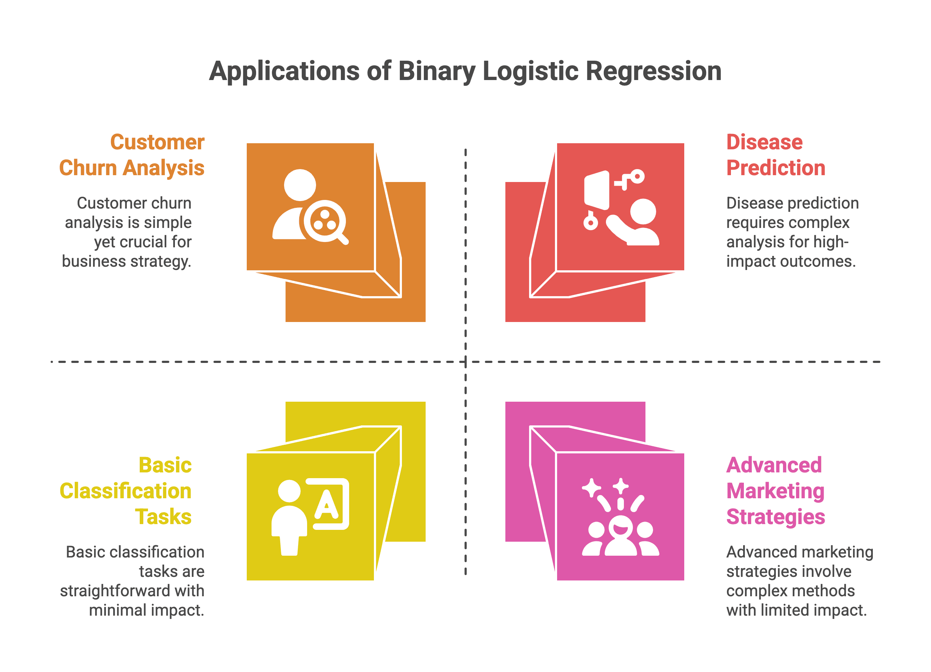
Common Use Cases
Logistic regression is widely used across various industries due to its interpretability and speed:
Medicine: Predicting the presence or absence of a disease based on patient vitals and test results.
Finance: Assessing the likelihood of a homeowner defaulting on a mortgage.
Marketing/Tech: Classifying whether an incoming email is spam or not spam.
Notes:
Ramon Perez is a Data Scientist with a vast experience in data analytics in roles ranging from industry and academic research to data science education. For the past two years, he had been working on developing what will hopefully become the first accredited data science bootcamp outside of a university setting in Australia. In the academic space, he has taught statistical programming at London Business School and have had the privilege to tutor and create lessons for a wide range of quantitative courses at Johns Hopkins Carey Business School. In addition, He has given tutorials at PyCon US, APAC, and Chile in 2021, SciPy Japan 2020, SciPy US 2021. He has also worked as a researcher at INSEAD where he developed machine learning models to recreate the organizational structure of any given company based on its historical job ads and those of similar companies. This project used a massive database of millions of job ads posted over the last 14 years in the US.

Slide 5
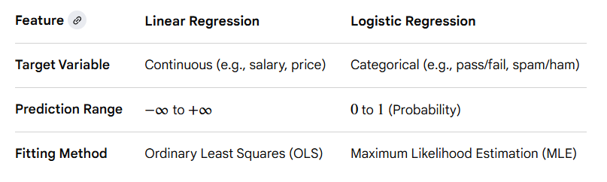
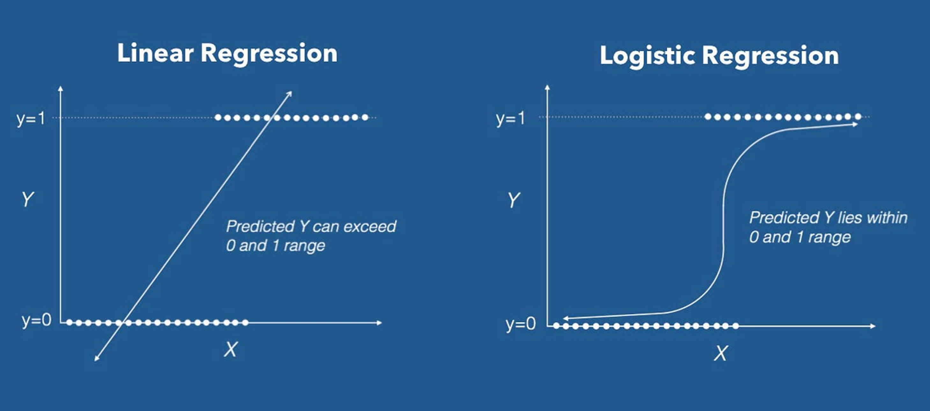
Key Differences from Linear Regression
Notes:
Ramon Perez is a Data Scientist with a vast experience in data analytics in roles ranging from industry and academic research to data science education. For the past two years, he had been working on developing what will hopefully become the first accredited data science bootcamp outside of a university setting in Australia. In the academic space, he has taught statistical programming at London Business School and have had the privilege to tutor and create lessons for a wide range of quantitative courses at Johns Hopkins Carey Business School. In addition, He has given tutorials at PyCon US, APAC, and Chile in 2021, SciPy Japan 2020, SciPy US 2021. He has also worked as a researcher at INSEAD where he developed machine learning models to recreate the organizational structure of any given company based on its historical job ads and those of similar companies. This project used a massive database of millions of job ads posted over the last 14 years in the US.

Slide 6
Thank you!

